Slide 1
Beyond Funding: The Essentials of Successful Promise Programs
A Presentation to the Growing Together
Higher Education Work Group

Slide 2
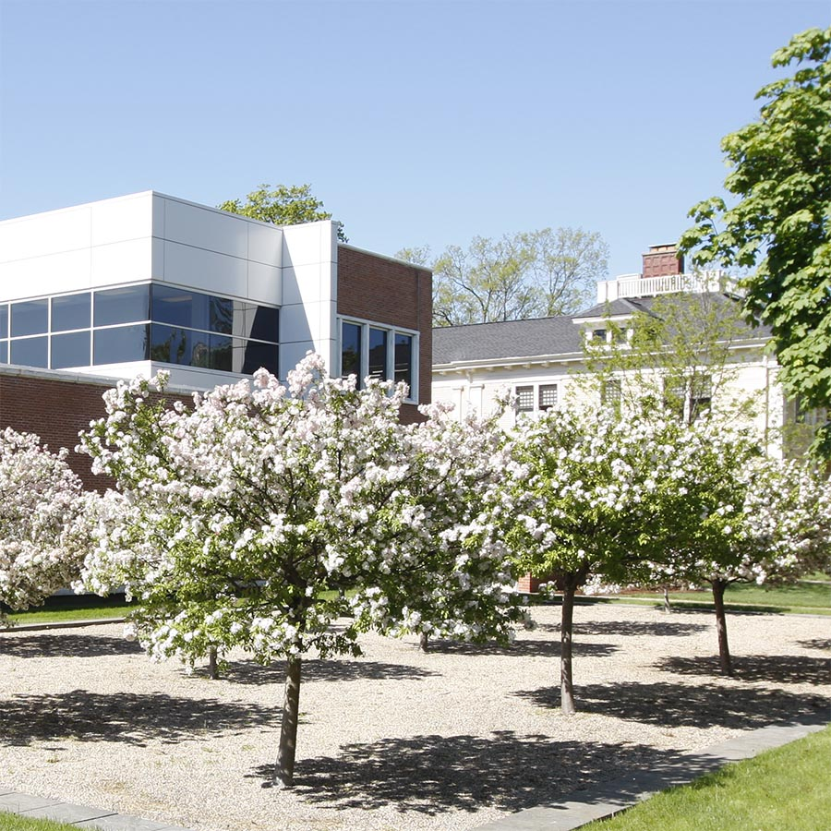

W.E. Upjohn Institute for Employment Research
Independent, not-for-profit, nonpartisan research institute founded in 1945 and based in Kalamazoo
Mission of studying policy-related issues of employment and unemployment, and experimenting with innovative ways to help the unemployed
Manage federally and state-funded workforce programs in 4-county region (Michigan Works! Southwest)
Manage grant-funded programs to provide wraparound services to individuals living in high-poverty areas facing serious barriers to work.
9/26/23

Slide 3
How do colleges and universities contribute to population growth and economic vitality?
Cities with educated residents grow faster than those without (Glaeser)
Regional universities (not just research flagships) make their local communities more resilient to economic downturns (Howard et al.)
Having more college graduates in a local economy raises the earnings of all local workers, including non-college graduates (Moretti)
“Eds and Meds” contribute to local economic development and stimulate the economy in multiple ways (Bartik and Erickcek)

Slide 4
The Promise landscape
  200+ communities and 20+ states have created a tuition-free pathway to post-secondary education for some segment of their population.
  The local and state movement is strong and growing.
  Rigorous research is limited, but the research base is growing.
  Michigan has >20 local Promise programs (including the Michigan Promise Zones) and one statewide program.
  Michigan also has its Sixty by 30 goal and an active Michigan College Access Network.

Slide 5
What does the research show?
Soft changes in attitudes and aspirations are common to most programs and detectable almost immediately
Many programs find K-12 enrollment increases within a year; often from keeping (rather than attracting new) students
Little evidence of HS graduation increase, but behavior and grades may improve
College enrollment increases are typical; persistence and completion are more variable (and less studied)

Slide 6
What does the research show?
Community-level impacts are often modest and depend on context.
Some migration in, but more likely less outmigration
Workforce outcomes are indeterminate, but some evidence that they’re positive
Return on investment through economic and fiscal benefits (studied theoretically)
Money and messaging are each important and can get students in the door, but additional supports from community needed for success

Slide 7
“There’s the money, and then there’s everything else.”
Navigation resources at critical transition points.
  Career paths to and through college
Support services for college success.
  New approaches to student success, serving new student populations
  More funds for schools, especially CCs, to provide these services (Deming & Walters)
  Most successful supports are layered (e.g., tuition + case management); giving money is easy, coordinating support is harder (but where the payoff is)
Messaging also matters
  Having a well-designed program with simple eligibility criteria can help.
Notes:
Navigation resources at critical transition points.
High school to college (choosing career path, best-fit institution/program).
College to workforce (internships, pathways programs).
Support services for college success.
Broadening pipeline to bring new population onto post-secondary pathway – may need additional supports (first-generation college-goers for example) – intrusive coaching, stipends, emergency grants, etc.
For (re)connecting adults to post-secondary pathway, may need other strategies – e.g., changes in how classes/support are offered by colleges.
These navigation and support services are not free; funding for them needs to be included.
Messaging also matters – having a simple program with limited eligibility criteria can help.

Slide 8
Bonus slide: Net flows of BA graduates across states
Darker green implies more net inflows; darker purple more net outflows
Michigan does better than most neighbors, except IL (Chicago)

Slide 9
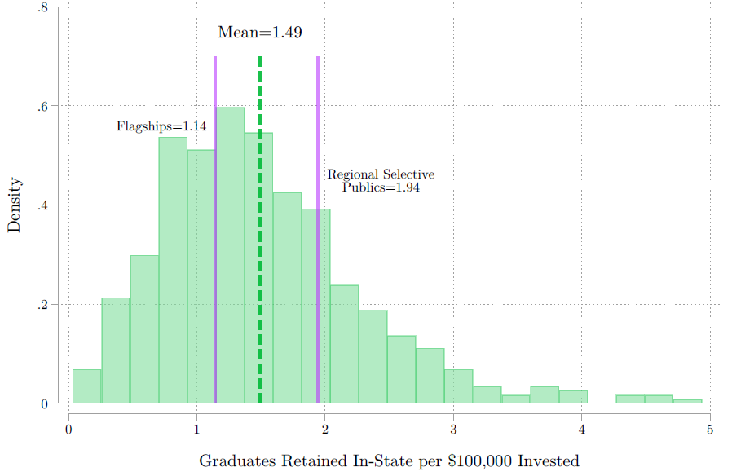
Bonus slide: ROI on higher ed investment
How many BA graduates do states retain per $100K spent*?
Depends on spending, grad rates, and net migration
Regional selective publics offer highest ROI because of high grad rates and less outmigration
* Includes appropriations + state grant aid

Slide 10
Questions?
  Dr. Michelle Miller-Adams, Senior Researcher, W.E. Upjohn Institute
  Miller-adams@upjohn.org
  For more resources on Promise Programs:
  Promise Program Database
  The Free College Handbook
  Promise Research Bibliographies
  The Kalamazoo Promise “Sweet Sixteen” – 16 Key Findings

